Slide 1
The road ahead in wind power: Innovation today for tomorrow’s challenges
Dr. Christoph Neemann, Head of Technology Management & Programs Siemens AG, Wind Power & Renewables Division

Slide 2
Wind power has proven ist ability to bring down costs. But the real disruptive part is still to come!
Learning curve: Onshore Levelised Cost of Electricity (LCOE)
EUR/MWh
350
~40 % of cost reduction per decade since 1980
350
350
<50EUR/MWh within next 15 years in most places globally
300
300
300
As of ~2020: On par with fossil full costs
250
250
250
As of ~2025-30: On par with fossil variable costs
200
200
200
150
150
150
100
100
100
LCOE range fossil fuels (coal/gas)
50
50
50
Variable costs fossil fuels (coal gas)
0
0
0
1980
1980
1985
1985
1990
1990
1995
1995
2000
2000
2005
2005
2010
2010
2015
2015
2020
2020
2025
2025
2030
1980
1990
2000
2010
2020
2030
2030
Annual installations actuals and
forecast
57,5
47,4
49,2
57,5
GW
39,6
6,7
20,1
1,5

Slide 3
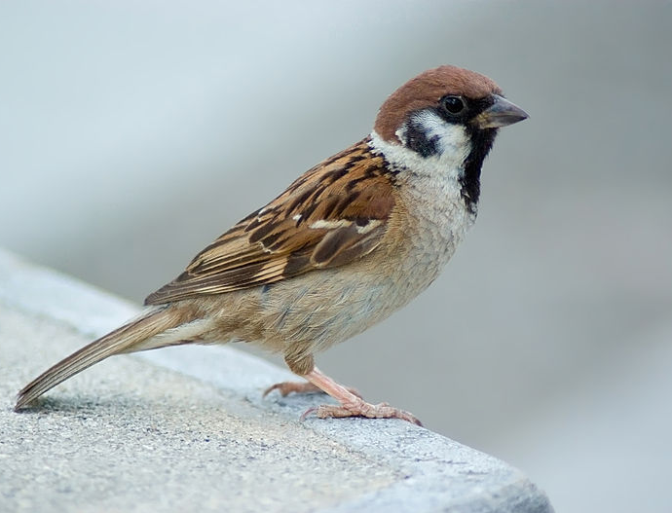
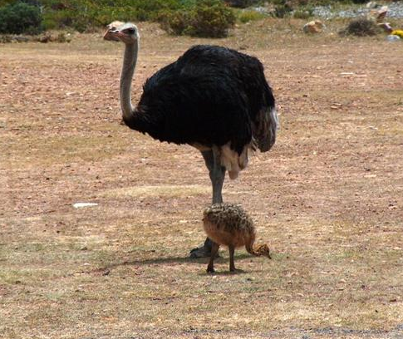
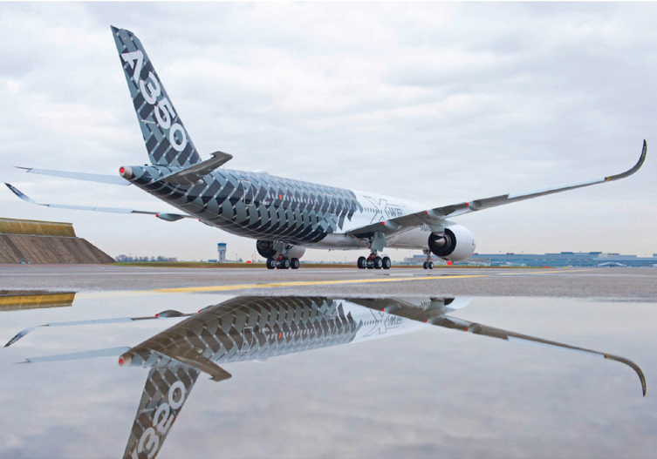
Big is beautiful: Size will continue to matter for bringing down the costs
Challenges ahead
LCOE Onshore
Hub height
EUR/MWh
m
Sources: Laitche (left), Andrew Massyn (right) (public domain)
400
200
300
150
Over-proportional cost growth
200
100
Sources: Airbus (left), Siemens (right)
100
50
0
0
1980
1990
2000
2010
Planning restrictions
70% of the LCOE reduction since 1980 can be attributed to size growth of wind turbines.
Notes:
https://commons.wikimedia.org/wiki/File:Tree_Sparrow_August_2007_Osaka_Japan.jpg
https://commons.wikimedia.org/wiki/File:Ostrich_and_chick.jpg

Slide 4
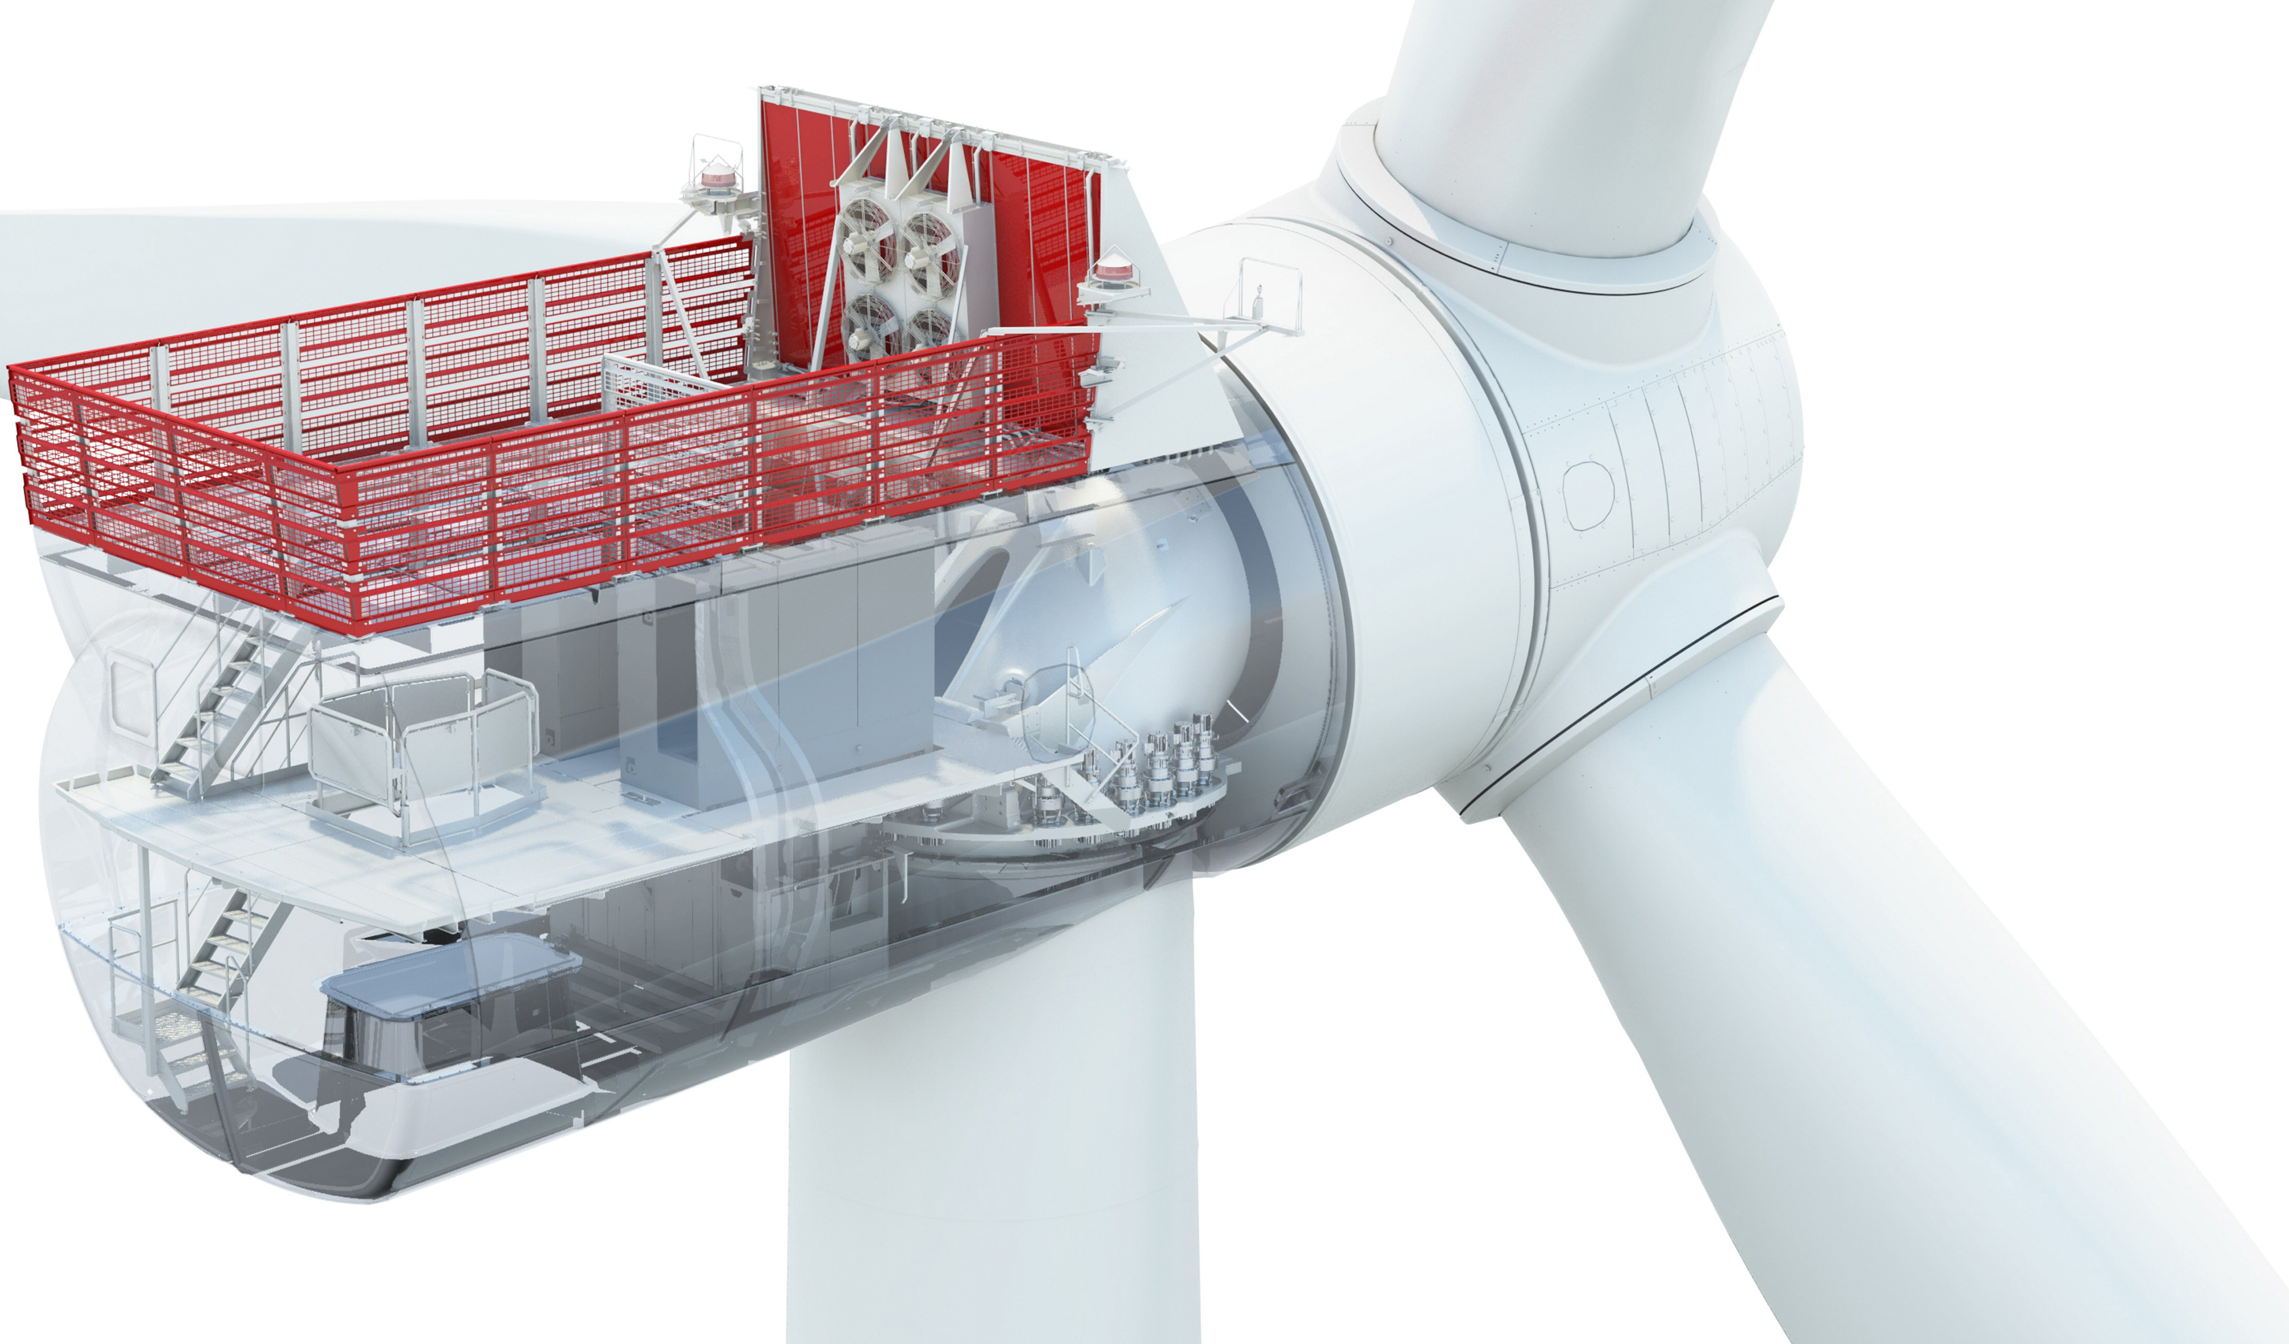
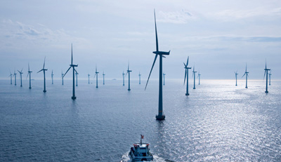
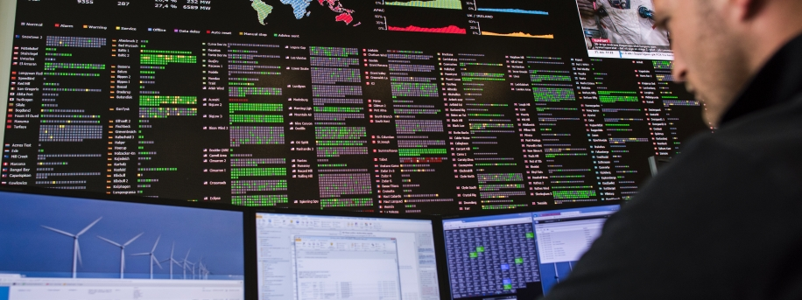
Think big, think bigger: Wind power has to acknowledge a larger role – combined with enlarged opportunities!
Examples
Wind farm
New materials
New generator concepts
Next generation modular concepts
Turbine
Energy system (incl heat and mobility)
Power system
Wind fleet
Flexible park configurations, based on real-time data
Farm availability management
Digital learning loops across fleet
Self-learning preventive maintenance
Virtual power plants
Optimised demand forecasts
Dispatchable wind generation
Auxiliary services
Smart demand/supply management power
Power 2 X
Opportunistic use of power to heat
Power to mobility: Demand management

Slide 5
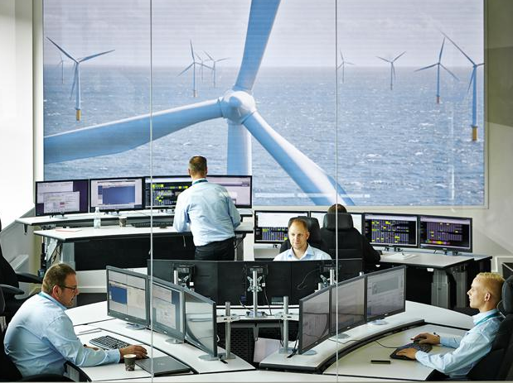
Example: Potential from digitalisation Remote diagnostics: using data to increase efficiency and reduce downtime
10,000
Wind turbines
24 Million Parameters
72 Terabytes
of new data annually
Notes:
…
The second key for us to remain competitive and profitable was to look at creative ways to broaden our offering to customers. In addition to building better products, we also had to get better at expanding into new markets. This means geographic markets like Northern Africa, the Middle East, and South America. But it also means broadening our existing markets; finding new ways to leverage our resources and add value. It wasn’t just our products that had to change, it was our thinking.
An article in the Harvard Business Review last year analyzed the concept of “ecosystem carryover.” That’s a fancy term for a fairly simply concept; it means using an existing market position to boost a position in a new market. For example, Apple using its iPod user base to launch the iPhone. The iPhone wasn’t that different from other phones - but there was an existing market of tens of millions of iPod users who all wanted to upgrade to the next generation device. It’s easy to forget that MP3 players and mobile phones were – until then – regarded as separate markets.
“Ecosystem carryover” is the ability to link separate markets – or what previously seemed like separate markets – into a single coherent opportunity. Some of you might be thinking, “But these are consumer electronics. Can this concept also apply to the energy business?” The answer is: Yes! Tesla, the electric car company, recently introduced the Powerwall, a battery-based power backup system for homes and businesses based on their electric car platform.
At Harvard they would call this an “ecosystem strategy” rather than a “product-based strategy.” And at Siemens Wind Power, we’re working hard to do this. Instead of just selling a wind turbine and walking away, we’re offering customers a complete wind power value chain consisting of smart turbines, distribution grids, energy storage solutions, load management systems, integrated switching and measuring devices, and intelligent monitoring. And of course we work closely with other Siemens Divisions, like Energy Management and Power Generation and Building Technologies, to provide truly integrated end-to-end services all built on common technology platforms. Like IBM, we want to offer not just hardware but solutions.
The telephone market is undergoing a remarkable transition. Customers no longer pay for airtime or ‘minutes,’ but only for bandwidth. In the energy industry, I believe a similar transformation is beginning to take place. With renewables – both wind and solar – the marginal cost of energy is extremely low. The only hard costs are capital costs. And soon this will be reflected in pricing and in business models.
Not surprisingly, digitalization is the key to many of these changes. Our goal, company-wide, is to become a truly digital company. We see tremendous business opportunities in vertical software, digital services, and digitally enhanced electrification and automation. And Siemens has a huge head start. Our strategy is to use our large installed base and deep industrial know-how to leverage these for profitable growth.
Wind turbines also generate a huge amount of data. Let me give you an example of how we’re using this digital data to offer better value and service. All of our customers want their turbines to run at peak capacity, producing power 24 hours a day, seven days a week. This reduces costs and produces the highest return on investment. To help achieve this, we created a Remote Diagnostics Center in Brande, Denmark, to collect this digital data from nearly 10,000 turbines in more than 30 countries. We gather information on more than 24 million parameters from our entire fleet. A generation ago this would have been inconceivable; today it’s not that difficult.
But collecting the data isn’t the hard part – the hard part is figuring out what to do with it. Sometimes you can miss the forest for the trees. We’re not a data center or a library, we’re a business. We want to use this data to make our products and services more efficient and effective. That’s the only way we can remain profitable.
So, to make sense of this huge volume of data, we developed algorithms to make it readable and to extract what’s most valuable. We’re now able to detect even the smallest deviations indicating potential problems long before they occur. Our technicians use processes like neural networks or digital twins which allow them to identify 98% of failures – things like gear tooth cracks or damage to main bearings – before any severe damage occurs. With 85% of expected outages, we can correct the problem and restart the turbine without a costly service team visit. And when we do have to send out a team, they receive remote support from the diagnostics center.
Our wind turbines generate more than 72 terabytes of new data annually. And there could potentially be even more ways to use or monetize this data, for marine shipping or weather forecasting for example.
There’s an excellent example right here in Norway that demonstrates the value of this data. There is a very successful company based in Oslo that doesn’t build wind turbines or any components, but that uses this digital data to develop management systems for wind farms. Their business is built on the data alone, not on gears, cables or fiberglass.^{[1]} Spotify used digitalization to create a new model for the music industry. Uber did the same in the taxi business. Digital data is now creating similar opportunities in the wind power business – for those creative enough to recognize its potential.
The next step is for our turbines to use this data themselves, to become truly “smart turbines” – turbines that automatically respond to changing situations and circumstances, maintaining peak efficiency without any human monitoring. That’s not a vision of the future, it’ something we’re already doing today. We are currently involved in a research project we call ALICE – this stands for “Autonomous Learning in Complex Environments”. It’s a project we’re working on together with a number of partners including the Technical University of Berlin. This research has already demonstrated that wind turbines can autonomously learn how to increase their power output by adjusting to weather conditions. And through a machine learning control loop, these self-optimizing wind turbines grow even smarter over time.
Another example how we’re using digitalization to be more efficient: we’re using our TC/NX platform to more effectively manage product data. We now have a system that allows our engineers to work on the same job from multiple locations simultaneously, allowing us to “go global” in product design. We’ve linked CAD models and documentation together to enhance efficiency and reduce duplication. We now have a system in place that integrates a wide range of functionalities and allows us to decrease the number of manual processes. And we’re now able to do Design Risk Assessment in a 3D environment before a product is actually manufactured, resulting not only in cost savings but in greater safety. It’s been demonstrated that these types of processes reduce the amount of required re-work by a factor of ten! That equals huge savings, of time, effort and money.
^{[1]} Baze Technology, Oslo

Slide 6
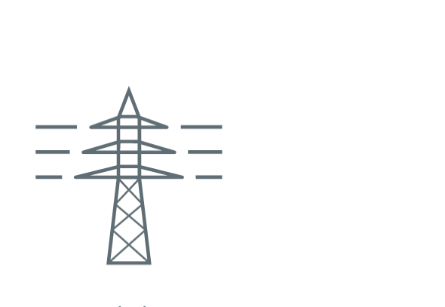
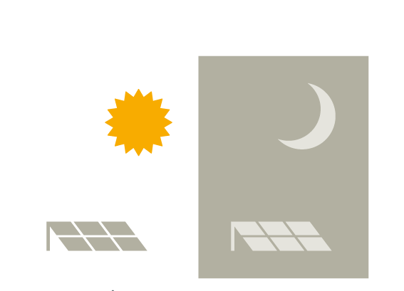
Wind power has been a joint success of public sector and industry efforts – let’s continue down that path!
What we can do as an industry
What governments and institutions can contribute
Make wind power cost competitive – onshore and offshore
Market-based support schemes and reliable boundary conditions
Take a larger role in the energy system
Create a level playing field: Phase-out subsidies for all mature technologies
Drive renewable penetration – through global presence and tailored offerings
Design and implement an energy system master plan: Ensure positive business case for all necessary players (e.g. storage)

